Slide 1


Python Web apI - Restful
viewset / router

Slide 2
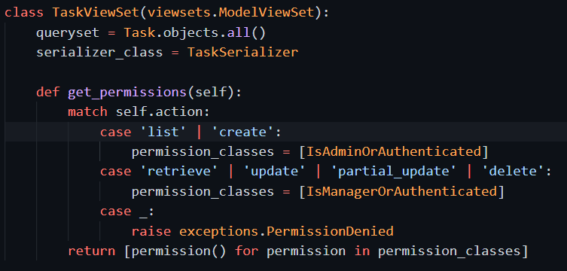
Viewset: one class for all views
The permission need customize, due to different view previously has different permission classes

Slide 3
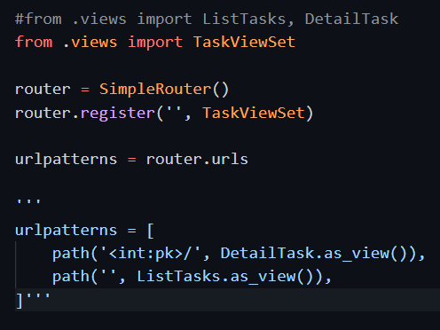
The url conf need change to use router

Slide 4
Check using curl
All same as before we did not change the view and url conf.

Slide 5
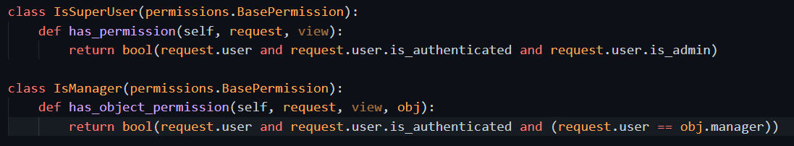
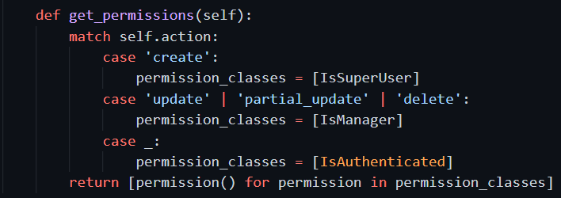
Can further change the permission for viewset

Slide 6
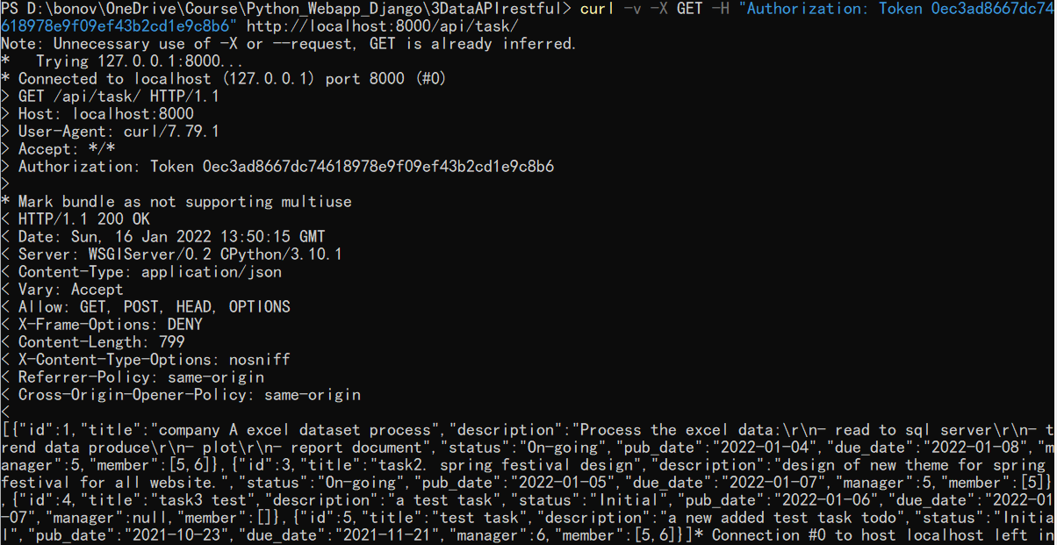
Any authenticated user can get data

Slide 7
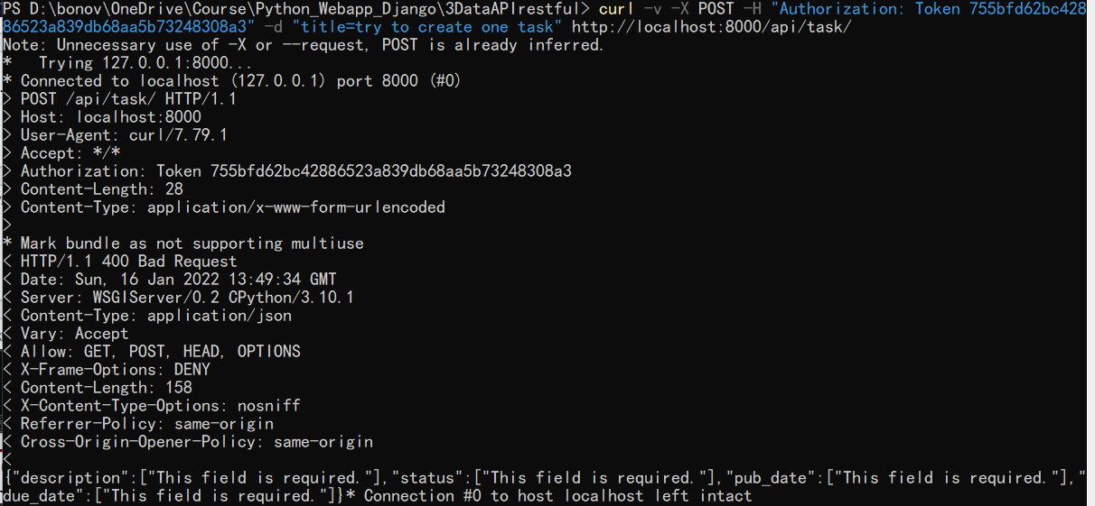
Super user can POST and create

Slide 8
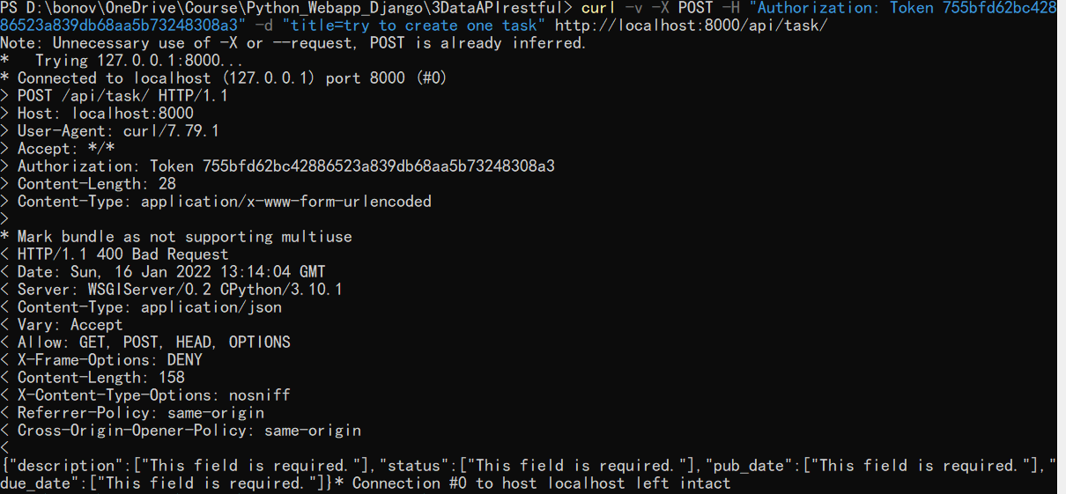
User curl to provide token
Because with browser we cannot add authorization header. So need use curl to add it and check. Follow request passed authorization, only request missing data.

Slide 9
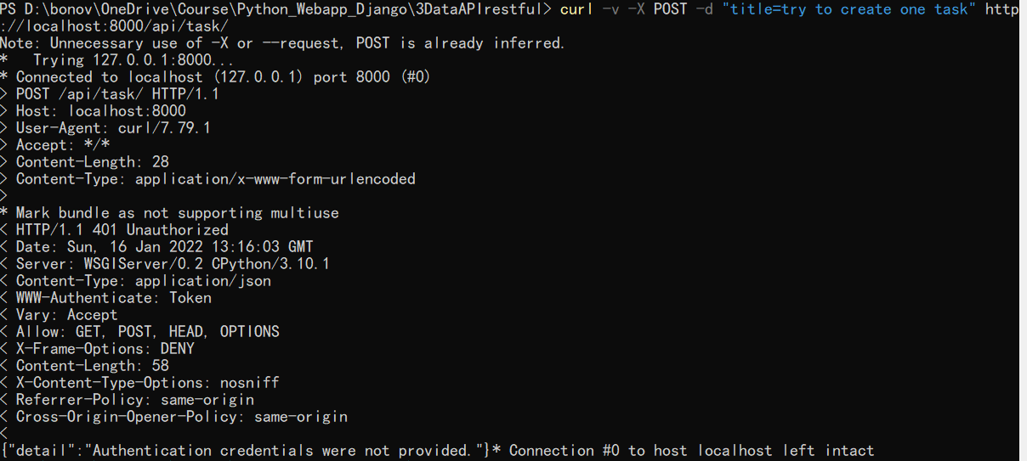
If with no token

Slide 10
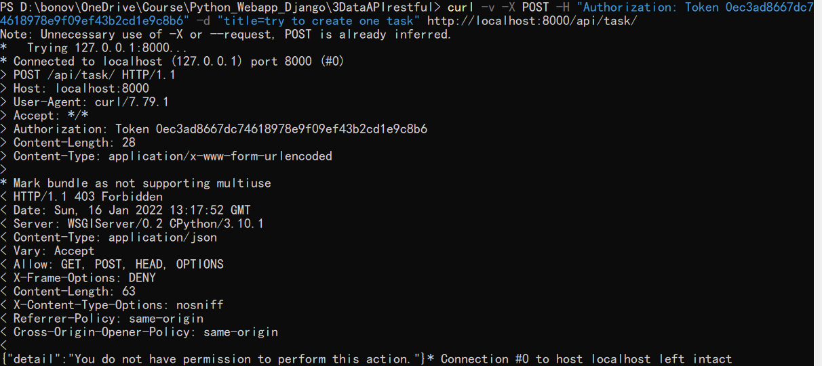
Or using token for another not authorized user (no create permission)

